Slide 1

Final Project
#3: Attribution Queries
Learn SQL from Scratch
Andrew Johncox
5/19/2019

Slide 2
Table of Contents
Get Familiar with CoolTShirts
Learning the User Journey?
Optimize the Campaign Budget 1
Optimize the Campaign Budget 2
Optimize the Campaign Budget 3
Choosing 5 Campaigns

Slide 3
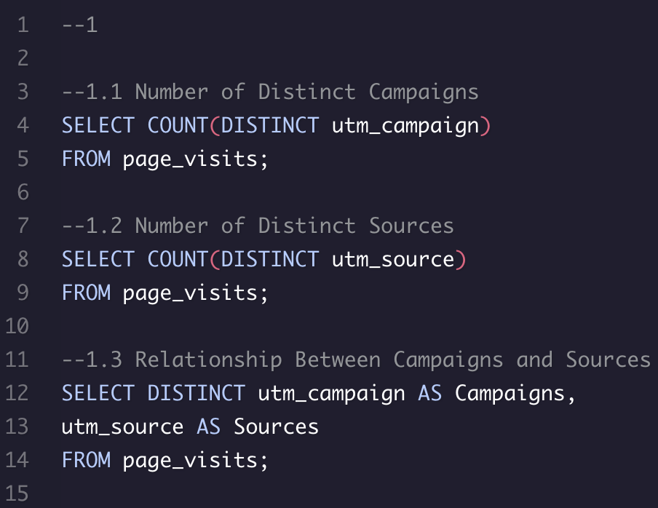
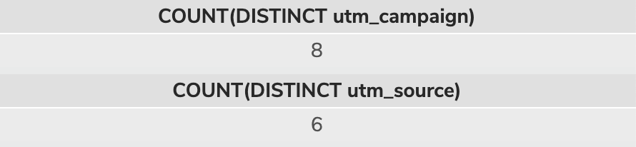
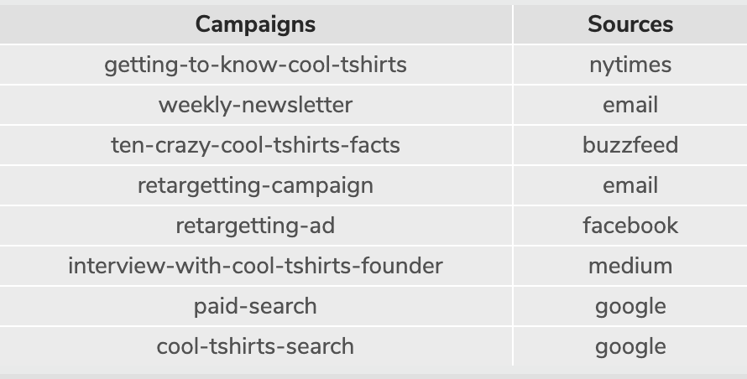
Get Familiar With CoolTShirts
Our first goal is to find preliminary information regarding CoolTShirts
The first 2 queries (1.1 and 1.2) find the number of distinct campaigns and sources. The results show 8 campaigns and 6 sources
1.3 Finds the relationship between campaigns and sources by showing sources per campaign

Slide 4
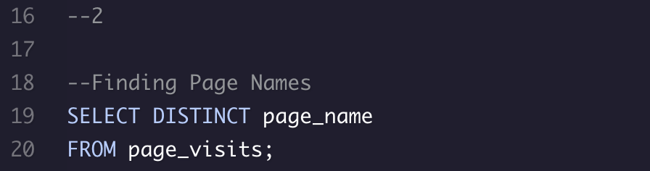

Learning the User Journey?
Query 2 is also building familiarity with CoolTShirts by showing the user journey.
We accomplish this with a relatively straight forward query for distinct pages.
Here we see there are 4 pages (listed below) associated with the purchase process.

Slide 5
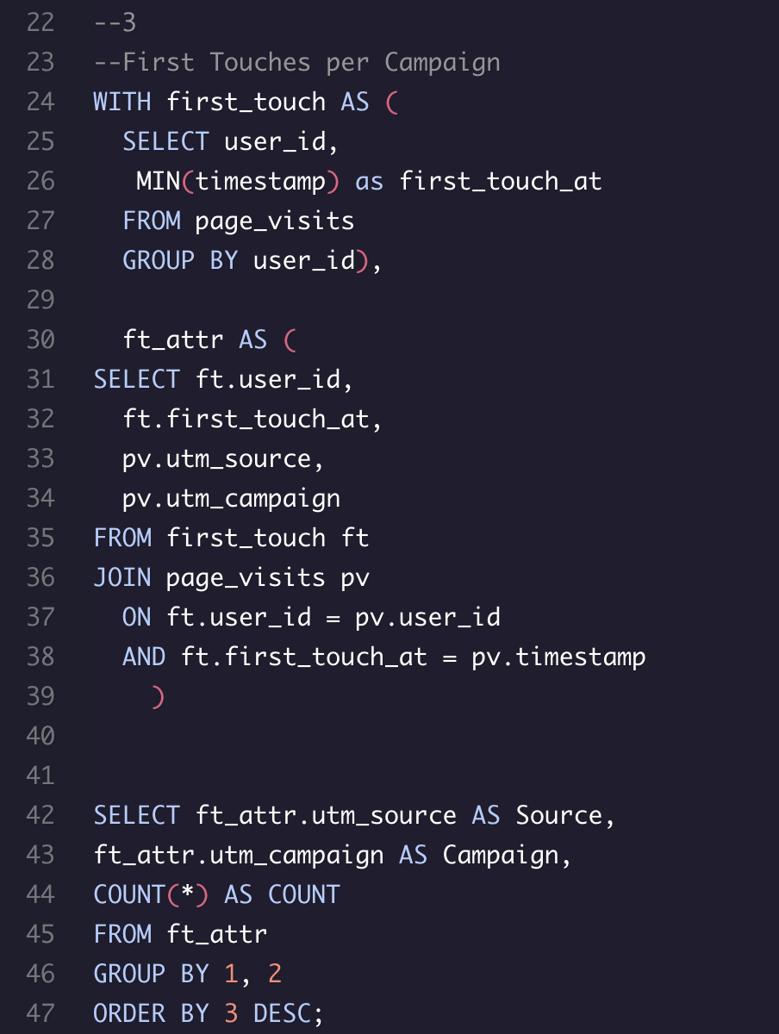
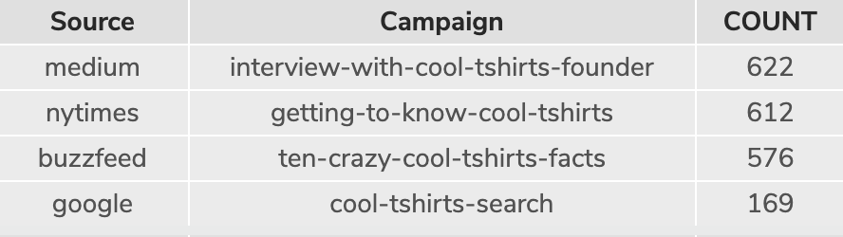
Optimize the Campaign Budget 1
Now we are going to look more in-depth at the campaigns, sources, and first touches (first visit generated by campaigns).
Here we use time stamps to determine first touch (lines 24-28).
We then join this table with page visit’s sources and campaigns (lines 30-39).
In the results below we see that only 4 of 8 campaigns found in 1.1 generate first touches. This most likely relates in part to source as two email sources probably relied on previous contact to garner the addresses.

Slide 6
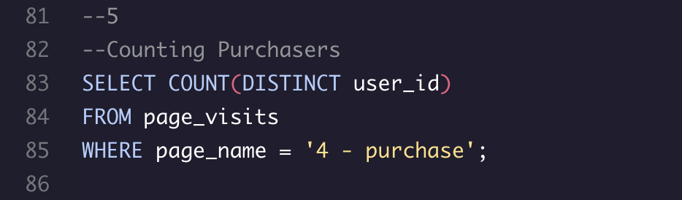

Optimize the Campaign Budget 2
Here we’re looking at the number of distinct purchases made.
This is a fairly simple query counting distinct users visiting the purchase page (4 - purchase).
Our number of purchases is 361.

Slide 7
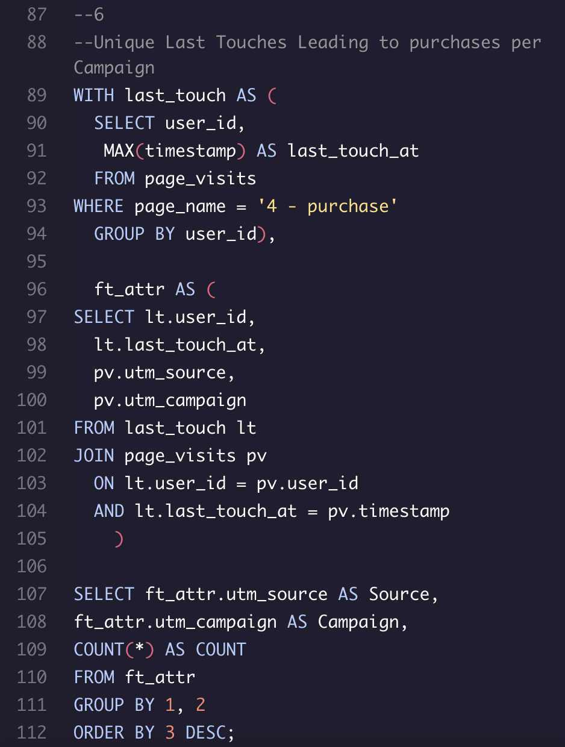
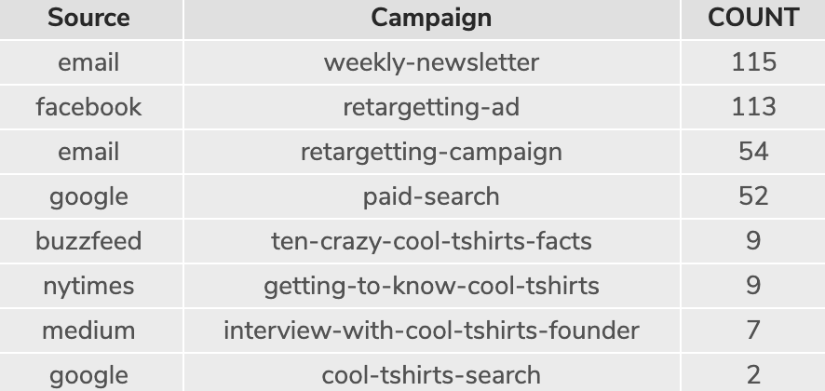
Optimize the Campaign Budget 3
Finally, we’re looking at the number of purchases per source and campaign.
To do this, we simply retool the query from “Optimize the Campaign Budget 1” to include the WHERE clause (line 93) from “Optimizing the Campaign Budget 2” which found users who visited page 4 – purchases.
This shows us the number of purchases per source and its associated campaign.

Slide 8
Choosing 5 Campaigns 1
Which 5 campaigns should CoolTShirts invest in?
First off, we need to recognize the limits of the data regarding the underlying phenomena and take a scientific approach.
There seem to be 6 high performing campaigns. A good starting place may be eliminating all but those 6 and using other factors to pick the final 5.
Ads seem to be segregated into those that generate first touches (high lighted blue) and those that generate sales (yellow). Last touches appear to be related to purchase volume, making the distinction less critical regarding if they lead to a purchase.
Therefore, looking at the sources in addition to first touches and purchases is critical to choosing the 5 we reinvest in.
Source | Campaign | 1st Touches | Percent of 1st Touches | Last Touches | Percent of Last Touches | Purchases | Percent of Purchases
google | cool-tshirts-search | 169 | 9% | 60 | 3% | 2 | 1%
nytimes | getting-to-know-cool-tshirts | 612 | 31% | 232 | 12% | 9 | 2%
medium | interview-with-cool-tshirts-founder | 576 | 31% | 232 | 12 | 9 | 2%
google | paid-search | 0 | 0% | 178 | 9% | 52 | 14%
facebook | retargeting-ad | 0 | 0% | 443 | 22% | 113 | 31%
email | retargeting-campaign | 0 | 0% | 245 | 12% | 54 | 15%
buzzfeed | ten-crazy-cool-tshirts-facts | 576 | 29% | 190 | 10% | 9 | 2%
email | weekly-newsletter | 0 | 0% | 447 | 23% | 115 | 32%

Slide 9
Choosing 5 Campaigns 2
Time for a deeper analysis:
The low Google search results seem to point to limited prior knowledge of CoolTshirts without prompting by first touches. We should probably focus on ads that boost awareness. We will elect to keep the 3 sources that boost awareness: Buzzfeed, NY Times, and Medium. Perhaps they will boost non-sponsored searches, which may be more lucrative due to not tapping the marketing budget and having proven to generate some sales.
Two retargeting sources use email. We aren’t sure how the email is collected, or if the emails have some kind of synergy in reminding potential customers. This could affect our decision. However, without this information, we will proceed with the info we have and assume a degree of independence.
Thus, we can simply cut the retargeting campaign, as at 15%, it is the lowest performing of the campaigns in generating last touches.
If possible, investing in making the 3 first touch campaigns also generate last touches could save resources due to their huge reach.
Source | Campaign | 1st Touches | Percent of 1st Touches | Last Touches | Percent of Last Touches | Purchases | Percent of Purchases
google | cool-tshirts-search | 169 | 9% | 60 | 3% | 2 | 1%
nytimes | getting-to-know-cool-tshirts | 612 | 31% | 232 | 12% | 9 | 2%
medium | interview-with-cool-tshirts-founder | 576 | 31% | 232 | 12 | 9 | 2%
google | paid-search | 0 | 0% | 178 | 9% | 52 | 14%
facebook | retargeting-ad | 0 | 0% | 443 | 22% | 113 | 31%
email | retargeting-campaign | 0 | 0% | 245 | 12% | 54 | 15%
buzzfeed | ten-crazy-cool-tshirts-facts | 576 | 29% | 190 | 10% | 9 | 2%
email | weekly-newsletter | 0 | 0% | 447 | 23% | 115 | 32%

Slide 10
Final Results
I recommend investing in the following 5 campaigns:
getting-to-know-cool-tshirts
interview-with-cool-tshirts-founder
retargeting-ad
retargeting-campaign
ten-crazy-cool-tshirts-facts
weekly-newsletter

